Slide 1
Quicksort

Slide 2
Introduction
Fastest known sorting algorithm in practice
Average case: O(N log N) (we don’t prove it)
Worst case: O(N²)
  But, the worst case seldom happens.
Another divide-and-conquer recursive algorithm, like mergesort

Slide 3
Quicksort
S
Divide step:
  Pick any element (pivot) v in S
  Partition S – {v} into two disjoint groups
  S1 = {x ∈ S – {v} | x <= v}
  S2 = {x ∈ S – {v} | x ≥ v}
Conquer step: recursively sort S1 and S2
Combine step: the sorted S1 (by the time returned from recursion), followed by v, followed by the sorted S2 (i.e., nothing extra needs to be done)
v
v
S1
S2
To simplify, we may assume that we don’t have repetitive elements,
So to ignore the ‘equality’ case!

Slide 4
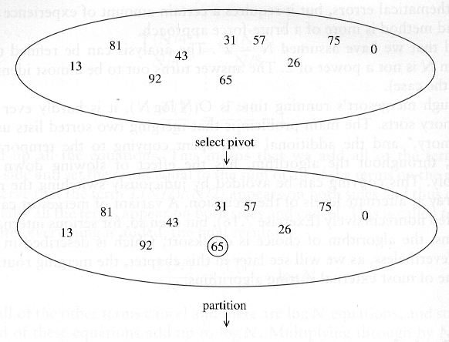
Example

Slide 5
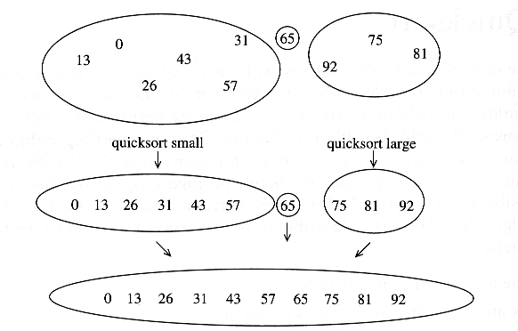

Slide 6
Pseudo-code
Input: an array a[left, right]
QuickSort (a, left, right) {
if (left < right) {
pivot = Partition (a, left, right)
Quicksort (a, left, pivot-1)
Quicksort (a, pivot+1, right)
}
}
Compare with MergeSort:
MergeSort (a, left, right) {
if (left < right) {
mid = divide (a, left, right)
MergeSort (a, left, mid-1)
MergeSort (a, mid+1, right)
merge(a, left, mid+1, right)
}
}

Slide 7
Two key steps
How to pick a pivot?
How to partition?

Slide 8
Pick a pivot
Use the first element as pivot
  if the input is random, ok
  if the input is presorted (or in reverse order)
    all the elements go into S2 (or S1)
    this happens consistently throughout the recursive calls
    Results in O(n²) behavior (Analyze this case later)
Choose the pivot randomly
  generally safe
  random number generation can be expensive

Slide 9
In-place Partition
  If use additional array (not in-place) like MergeSort
    Straightforward to code like MergeSort (write it down!)
    Inefficient!
  Many ways to implement
  Even the slightest deviations may cause surprisingly bad results.
    Not stable as it does not preserve the ordering of the identical keys.
    Hard to write correctly ☹

Slide 10
An easy version of in-place partition to understand,
but not the original form
int partition(a, left, right, pivotIndex) {
pivotValue = a[pivotIndex];
swap(a[pivotIndex], a[right]); // Move pivot to end
// move all smaller (than pivotValue) to the begining
storeIndex = left;
for (i from left to right) {
if a[i] < pivotValue
swap(a[storeIndex], a[i]);
storeIndex = storeIndex + 1 ;
}
swap(a[right], a[storeIndex]); // Move pivot to its final place
return storeIndex;
}
Look at Wikipedia

Slide 11
quicksort(a,left,right) {
if (right>left) {
pivotIndex = left;
select a pivot value a[pivotIndex];
pivotNewIndex=partition(a,left,right,pivotIndex);
quicksort(a,left,pivotNewIndex-1);
quicksort(a,pivotNewIndex+1,right);
}
}

Slide 12
A better partition
Want to partition an array A[left .. right]
First, get the pivot element out of the way by swapping it with the last element. (Swap pivot and A[right])
Let i start at the first element and j start at the next-to-last element (i = left, j = right – 1)
swap
5
6
4
6
3
12
19
5
6
4
19
3
12
6
pivot
i
j

Slide 13
Want to have
  A[x] <= pivot, for x < i
  A[x] >= pivot, for x > j
When i < j
  Move i right, skipping over elements smaller than the pivot
  Move j left, skipping over elements greater than the pivot
  When both i and j have stopped
    A[i] >= pivot
    A[j] <= pivot
<= pivot
>= pivot
i
j
5
6
4
19
3
12
6
5
6
4
19
3
12
6
i
j
i
j

Slide 14
When i and j have stopped and i is to the left of j
  Swap A[i] and A[j]
    The large element is pushed to the right and the small element is pushed to the left
  After swapping
    A[i] <= pivot
    A[j] >= pivot
  Repeat the process until i and j cross
swap
5
6
4
19
3
12
6
5
3
4
19
6
12
6
i
j
i
j

Slide 15
When i and j have crossed
  Swap A[i] and pivot
Result:
  A[x] <= pivot, for x < i
  A[x] >= pivot, for x > i
5
3
4
19
6
12
6
i
j
5
3
4
19
6
12
6
j
i
5
3
4
6
6
12
19
j
i

Slide 16
Implementation (put the pivot on the leftmost instead of rightmost)
void quickSort(int array[], int start, int end)
{
int i = start; // index of left-to-right scan
int k = end; // index of right-to-left scan
if (end - start >= 1) // check that there are at least two elements to sort
{
int pivot = array[start]; // set the pivot as the first element in the partition
while (k > i) // while the scan indices from left and right have not met,
{
while (array[i] <= pivot && i <= end && k > i) // from the left, look for the first
i++; // element greater than the pivot
while (array[k] > pivot && k >= start && k >= i) // from the right, look for the first
k--; // element not greater than the pivot
if (k > i) // if the left seekindex is still smaller than
swap(array, i, k); // the right index,
// swap the corresponding elements
}
swap(array, start, k); // after the indices have crossed,
// swap the last element in
// the left partition with the pivot
quickSort(array, start, k - 1); // quicksort the left partition
quickSort(array, k + 1, end); // quicksort the right partition
}
else // if there is only one element in the partition, do not do any sorting
{
return; // the array is sorted, so exit
}
}
Adapted from http://www.mycsresource.net/articles/programming/sorting_algos/quicksort/

Slide 17
void quickSort(int array[])
// pre: array is full, all elements are non-null integers
// post: the array is sorted in ascending order
{
quickSort(array, 0, array.length - 1); // quicksort all the elements in the array
}
void quickSort(int array[], int start, int end)
{
…
}
void swap(int array[], int index1, int index2) {…}
// pre: array is full and index1, index2 < array.length
// post: the values at indices 1 and 2 have been swapped

Slide 18
With duplicate elements …
  Partitioning so far defined is ambiguous for duplicate elements (the equality is included for both sets)
  Its ‘randomness’ makes a ‘balanced’ distribution of duplicate elements
  When all elements are identical:
    both i and j stop → many swaps
    but cross in the middle, partition is balanced (so it’s n log n)
Notes:
If neither i nor j stops, no swaps will be performed (needs code). But the pivot is at the end, unbalanced partition
Leads to n^2.

Slide 19
A better Pivot
Use the median of the array
  Partitioning always cuts the array into roughly half
  An optimal quicksort (O(N log N))
  However, hard to find the exact median (chicken-egg?)
    e.g., sort an array to pick the value in the middle
  Approximation to the exact median: …

Slide 20
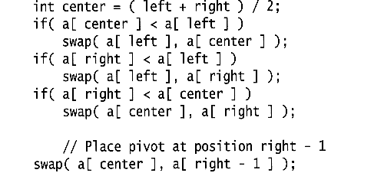
Median of three
We will use median of three
  Compare just three elements: the leftmost, rightmost and center
  Swap these elements if necessary so that
    A[left] = Smallest
    A[right] = Largest
    A[center] = Median of three
  Pick A[center] as the pivot
  Swap A[center] and A[right – 1] so that pivot is at second last position (why?)
median3

Slide 21
2
5
6
4
13
3
12
19
6
A[left] = 2, A[center] = 13, A[right] = 6
2
5
6
4
6
3
12
19
13
Swap A[center] and A[right]
2
5
6
4
6
3
12
19
13
Choose A[center] as pivot
pivot
2
5
6
4
19
3
12
6
13
Swap pivot and A[right – 1]
pivot
Note we only need to partition A[left + 1, …, right – 2]. Why?

Slide 22
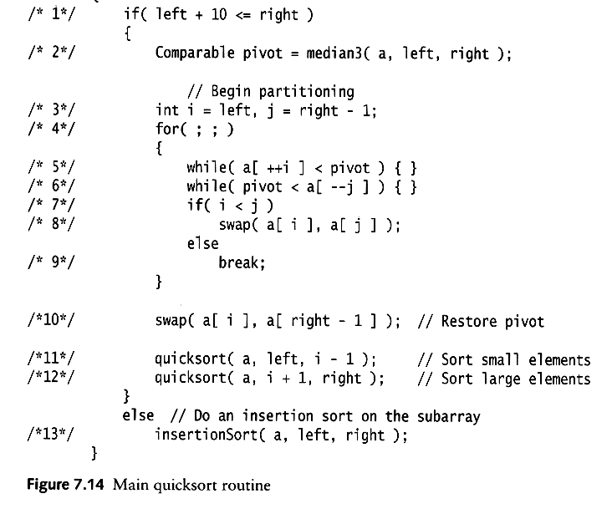
Works only if pivot is picked as median-of-three.
  A[left] <= pivot and A[right] >= pivot
  Thus, only need to partition A[left + 1, …, right – 2]
j will not run past the beginning
  because a[left] <= pivot
i will not run past the end
  because a[right-1] = pivot
The coding style is efficient, but hard to read ☹

Slide 23
i=left;
j=right-1;
while (1) {
do i=i+1;
while (a[i] < pivot);
do j=j-1;
while (pivot < a[j]);
if (i<j) swap(a[i],a[j]);
else break;
}

Slide 24
Small arrays
For very small arrays, quicksort does not perform as well as insertion sort
  how small depends on many factors, such as the time spent making a recursive call, the compiler, etc
Do not use quicksort recursively for small arrays
  Instead, use a sorting algorithm that is efficient for small arrays, such as insertion sort

Slide 25
A practical implementation
Choose pivot
Partitioning
Recursion
For small arrays

Slide 26
Quicksort Analysis
Assumptions:
  A random pivot (no median-of-three partitioning)
  No cutoff for small arrays
Running time
  pivot selection: constant time, i.e. O(1)
  partitioning: linear time, i.e. O(N)
  running time of the two recursive calls
T(N)=T(i)+T(N-i-1)+cN where c is a constant
  i: number of elements in S1

Slide 27
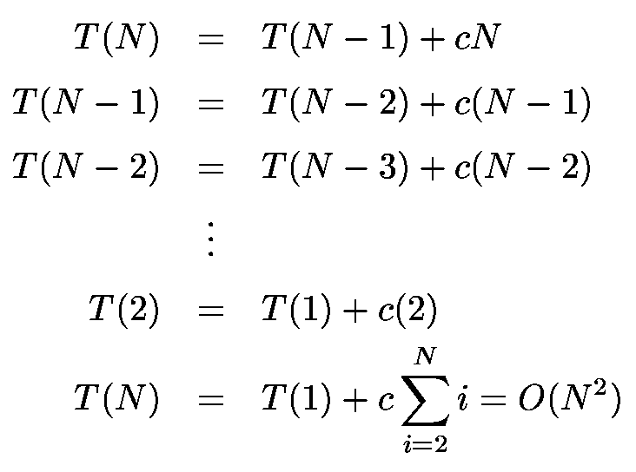
Worst-Case Analysis
What will be the worst case?
  The pivot is the smallest element, all the time
  Partition is always unbalanced

Slide 28
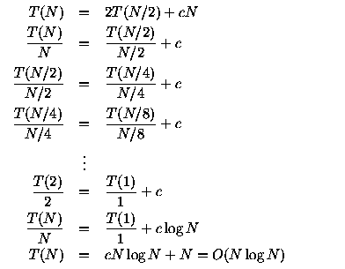
Best-case Analysis
What will be the best case?
  Partition is perfectly balanced.
  Pivot is always in the middle (median of the array)

Slide 29
Average-Case Analysis
Assume
  Each of the sizes for S1 is equally likely
This assumption is valid for our pivoting (median-of-three) strategy
On average, the running time is O(N log N) (covered in comp271)

Slide 30
Quicksort is ‘faster’ than Mergesort
Both quicksort and mergesort take O(N log N) in the average case.
Why is quicksort faster than mergesort?
  The inner loop consists of an increment/decrement (by 1, which is fast), a test and a jump.
  There is no extra juggling as in mergesort.
inner loop

